Slide 1




Real-Time Attendance System with Client-Server Communication
Developed a real-time attendance system with client-server communication, enabling users to input data and mark attendance interactively.

Slide 2

Prepared by:
Bahnikana Biswas (21051214)
Akarsh Verma (21051197)
Project Supervisor:
Dr. Tanmoy Maitra

Slide 3
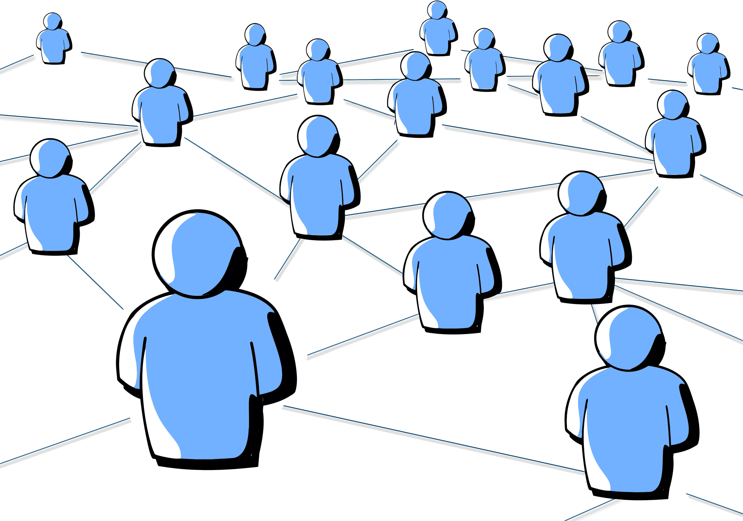

ACKNOWLEDGEMENT
I I would like to express my sincere gratitude to the contributors of this project. Special thanks to the open-source community for providing invaluable resources and libraries, facilitating the development of the real-time attendance system. Additionally, I appreciate the guidance and support received from our professor Dr. Tanmoy Maitra throughout the project's implementation.

Slide 4


ABSTRACT
This project presents a Real-Time Attendance System with a user-friendly interface, a 45-minute timer, and efficient server-side data storage. Versatile for diverse settings, it showcases networking expertise, open-source integration, and comprehensive documentation for future scalability and maintainability.

Slide 5

OBJECTIVES
Establish Communication:
Set up robust client-server communication for seamless data exchange.
User-Friendly Interface:
Develop an intuitive client interface for convenient data input.
Timer Integration:
Implement a 45-minute timer for enhanced user engagement and attendance automation.
Efficient Data Storage:
Store attendance records systematically on the server for accuracy and accessibility.
Manage Multiple Clients:
Enable the server to handle concurrent interactions from multiple clients.
Versatile Deployment:
Design the system for deployment in diverse educational and organizational settings.
Networking Proficiency:
Showcase expertise in networking concepts, utilizing socket-based communication.
Enhance Accountability:
Provide a tool that enhances accountability and engagement in attendance tracking.
Open-Source Utilization:
Utilize open-source components and libraries for enhanced functionality.
Documentation and Knowledge Transfer:
Thoroughly document the project for knowledge transfer, ensuring maintainability.

Slide 6
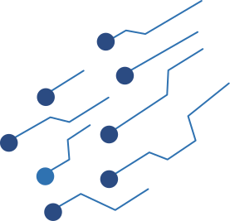

INTRODUCTION
The Real-Time Attendance System redefines attendance tracking in educational and organizational domains through an innovative client-server model. Offering a user-friendly interface and a 45-minute timer for enhanced engagement, the system streamlines attendance input and automates marking. Efficient server-side data storage ensures meticulous record-keeping, adapting seamlessly to diverse environments and fostering real-time collaboration.
Highlighting networking expertise and open-source integration, the project emphasizes collaborative development. Comprehensive documentation supports future maintainability and scalability, solidifying the Real-Time Attendance System as a dynamic and adaptive solution to the evolving landscape of attendance management.

Slide 7

BUILT WITH
The technologies and tools used are:
Python Language
Linux
Socket
FEATURES
Timer Based Attendance
Auto Updation of Attendance in CSV File
Lab ChatRoom
Updates to systems from Server

Slide 8

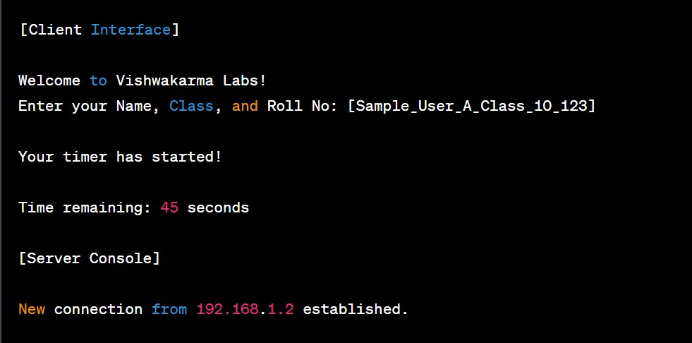
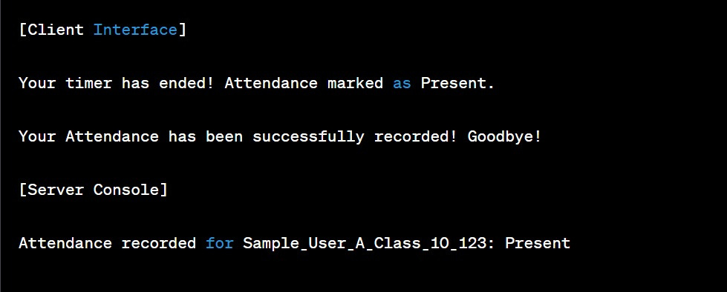
RESULTS/OUTPUT

Slide 9

CONCLUSION
In conclusion, the Real-Time Attendance System not only addresses the immediate needs of attendance tracking but also positions itself as a forward-thinking solution for the evolving landscape of educational and organizational requirements. Its success lies in the fusion of technology, user-centric design, and collaborative principles, promising an enhanced and streamlined approach to attendance management.

Slide 10

FUTURE SCOPE
The Real-Time Attendance System exhibits potential for future development, including the integration of biometric authentication, predictive analytics through machine learning, and the development of a mobile application. Enhanced reporting, geolocation tracking, and user customization are additional features that could be incorporated. Integration with Learning Management Systems, multi-factor authentication, cloud services, and a feedback mechanism for continuous improvement further extend the system's capabilities. Exploring gamification elements, accessibility features, and ensuring a user-friendly experience contribute to the system's adaptability and evolution in response to the dynamic needs of educational and organizational environments.

Slide 11




















Referencs
https://www.geeksforgeeks.org/computer-network-tutorials/
https://www.geeksforgeeks.org/client-server-model/
https://en.wikipedia.org/wiki/Client%E2%80%93server_model
https://networksimulationtools.com/computer-network-project-topics/
https://networksimulationtools.com/computer-network-project-topics/
https://projectsgeek.com/networking-projects-computer-science

